Slide 1


IPL DATA ANALYSIS
By:- Alankar Singh

Slide 2
EXECUTION SUMMARY
The IPL data contain total 2 sheet with dashboard.
In first sheet total 18 column and 817 row.
In second sheet total 30 column and 631 row.
The project is made by using pivot table, conditional formatting, filters, and function is also used like vlookup, and, or and etc.

Slide 3
PROBLEM STATEMENTS
Matches win by each team with respect of bat first or field first.
Toss decision based winning result.
Maximum title winner.
Maximum number of man of the match award goes to.
Top 10 venues according to matches played and winning result.
Matches played by each team.
Find the top 10 run scorer.
Maximum half-centuries by players.
Most century by players.
Find top 5 wicket taker bowler.

Slide 4
Matches win by each team with respect of bat first or field first .
Jcbua

Slide 5
Toss decision based winning result.
man

Slide 6
Maximum title winner.
njdbc

Slide 7
Maximum number of man of the match award goes to.
jcugcj

Slide 8
Top 10 venues according to matches played and winning result.
cvjdbc

Slide 9
Matches played by each team.
kfoadc

Slide 10
Find the top 10 run scorer.
V,dsv

Slide 11
Maximum half-centuries by players.
man

Slide 12
Most century by players.
amnk

Slide 13
Find top 5 wicket taker bowler.
skcm

Slide 14
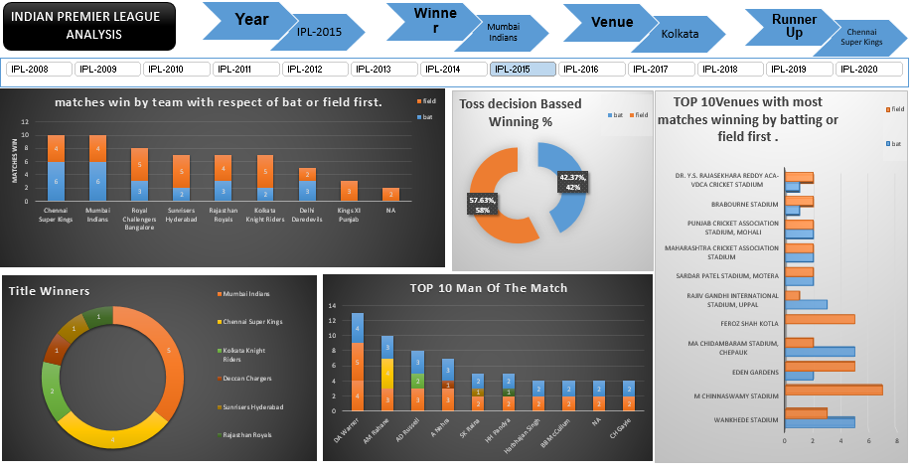
DASHBOARD - 1

Slide 15
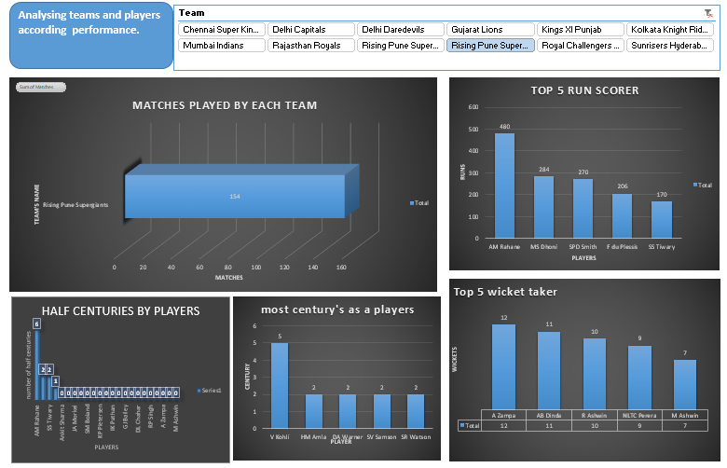
DASHBOARD - 2

Slide 16
Conclusion
Here is data of IPL ,Which help of data we can check the performance of teams and players according to there past records.

